Slide 1
INFO-1252
Front-End Web Development
Lab #1

Slide 2
Lab 1 Instructions
Using Notepad++ re-create the following screenshots on the next slides to create 3 HTML pages: index.html, about.html and services.html
Download the lab 1.zip from Week 1 on FOL (Content section)
Create a folder called INFO1148 > w1
Extract the zip folder into the w1 folder
Use the resources in this folder to create your 3 HTML pages
Text and images are provided
Once completed, zip your w1 folder (will then appear as w1.zip in same folder)
Submit your w1.zip folder to the Lab 1 submission dropbox on FOL

Slide 3
Lab 1 Grading
Marks are given for:
Proper strict code
Comments
Nesting
Spacing
Syntax (no errors)
/10

Slide 4
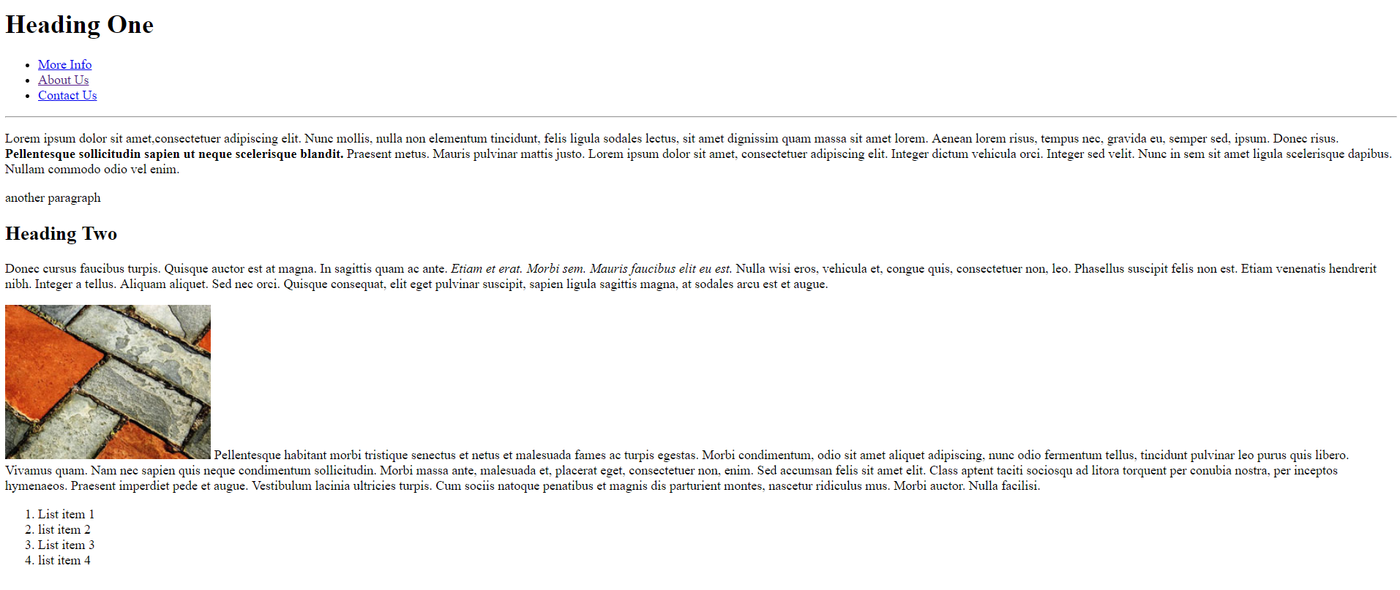
Screenshot of index.html

Slide 5
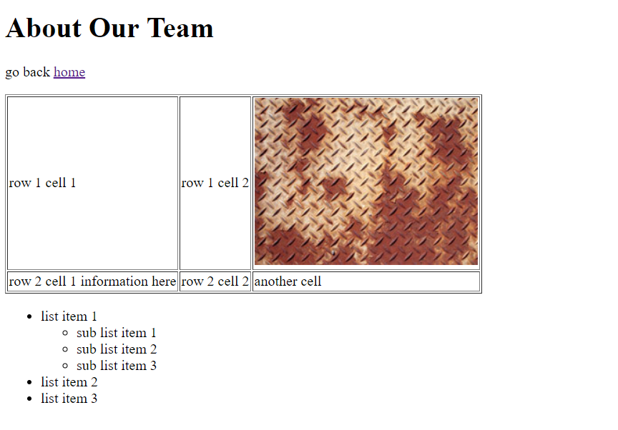
Screenshot of about.html

Slide 6
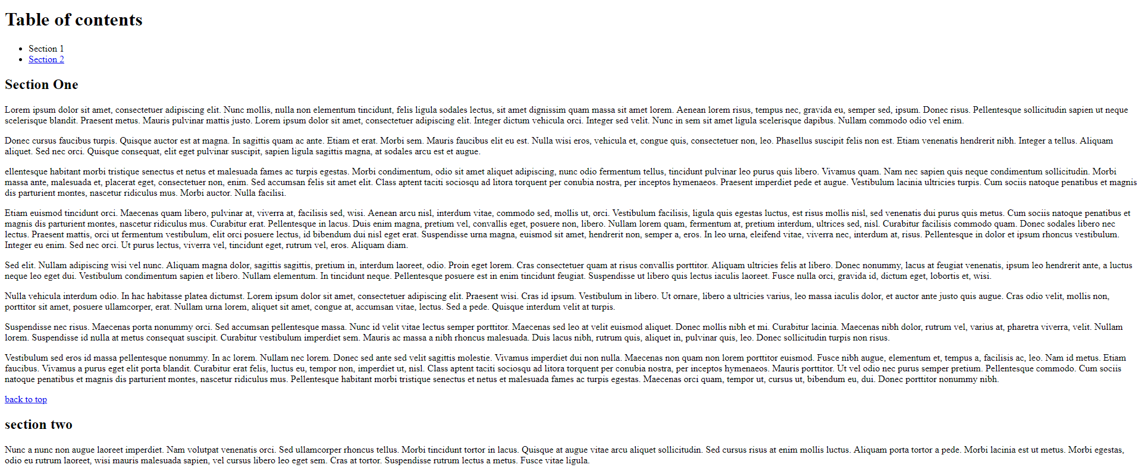
Screenshot of services.html

